Slide 1
Tutorial 6:
Managing Multiple Worksheets and Workbooks

Slide 2
Objectives
Create a worksheet group
Format and edit multiple worksheets at once
Create cell references to other worksheets
Consolidate information from multiple worksheets using 3-D references
Create and print a worksheet group

Slide 3
Objectives
Create a link to data in another workbook
Create a workbook reference
Learn how to edit links
Insert a hyperlink in a cell
Create a workbook based on an existing template
Create a custom workbook template

Slide 4
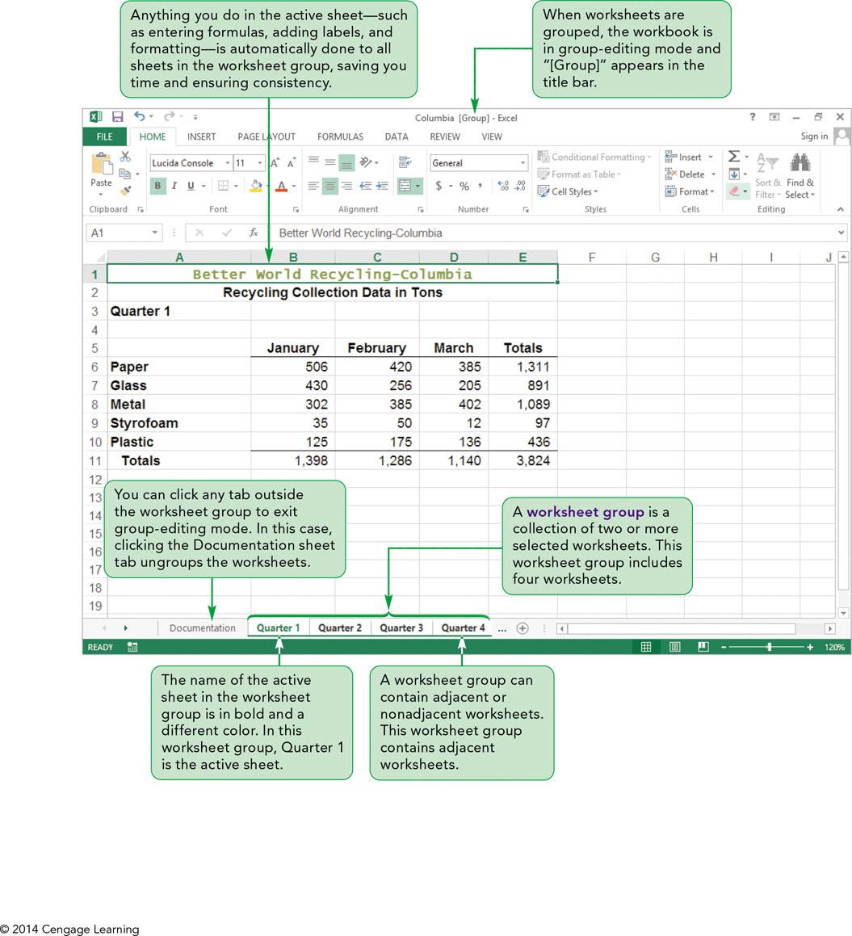
Visual Overview: Worksheet Groups and 3-D References

Slide 5
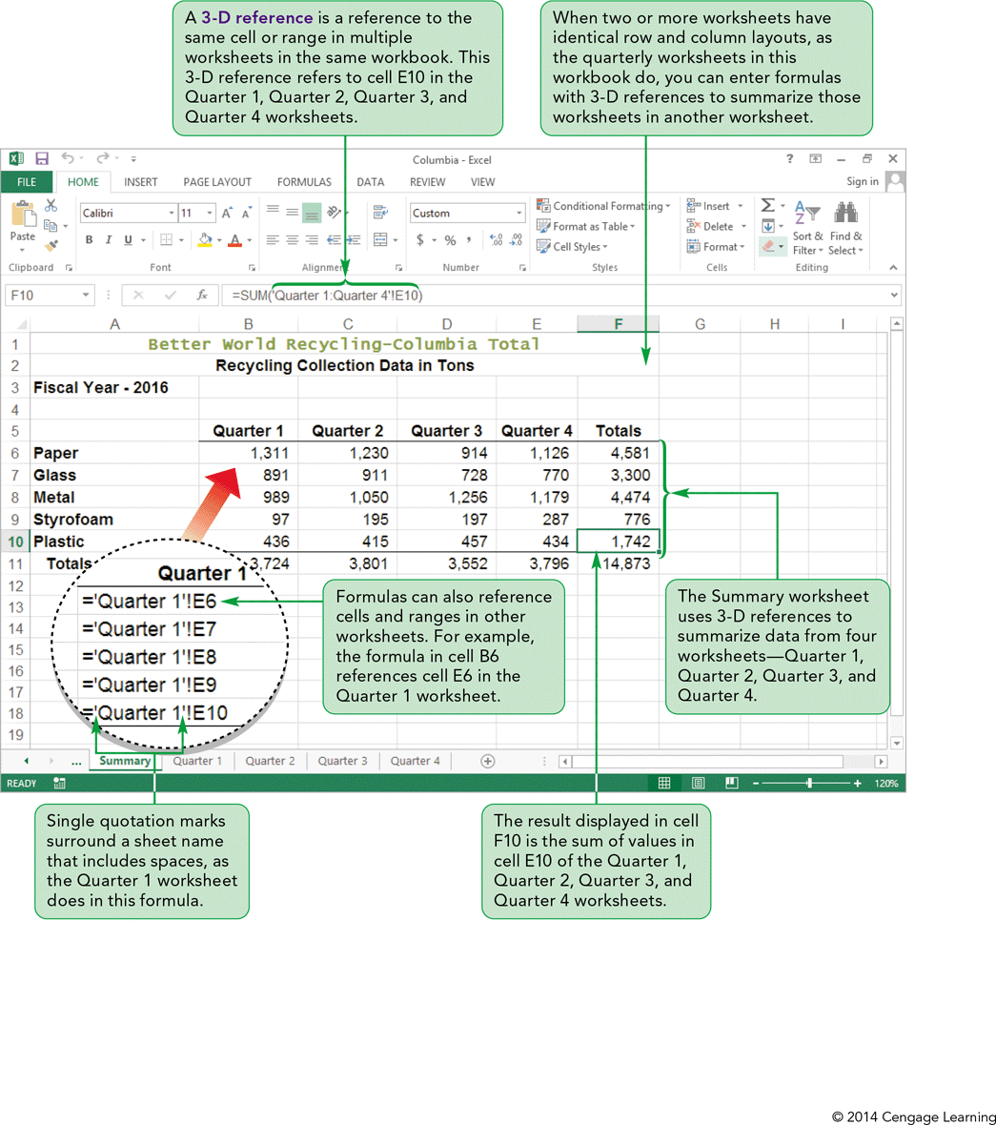
Visual Overview: Worksheet Groups and 3-D References

Slide 6
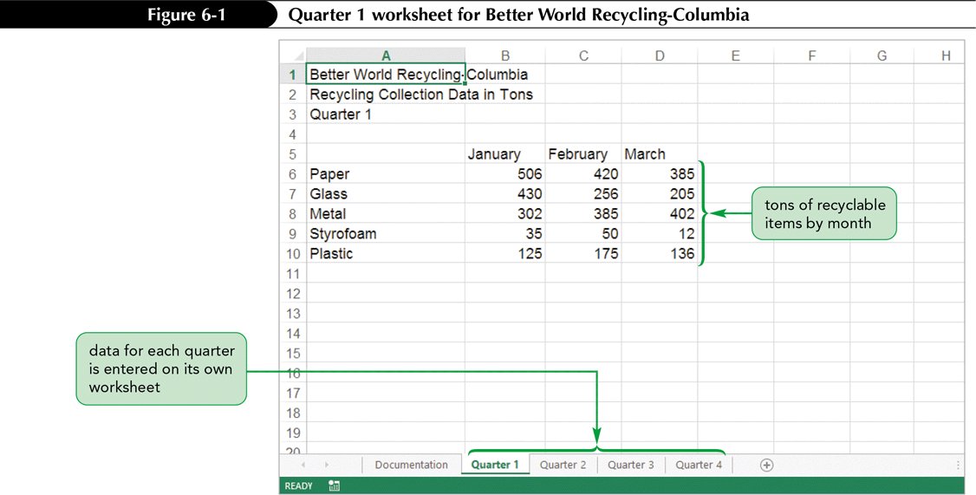
Grouping Worksheets
Using multiple worksheets:
  Makes it easier to group and summarize data
  Enables you to place summarized data first

Slide 7
Grouping Worksheets
Rather than retyping the formulas in each worksheet, you can enter them all at once by creating a worksheet group
A worksheet group can contain adjacent or nonadjacent worksheets
In group-editing mode, most editing tasks that you complete in the active worksheet also affect the other worksheets in the group

Slide 8
Grouping Worksheets
By forming a worksheet group, you can:
  Enter or edit data and formulas
  Apply formatting
  Insert or delete rows and columns
  Set the page layout options
  Apply view options
  Print all the worksheets
Worksheet groups save you time and help improve consistency among the worksheets because an action affects multiple worksheets

Slide 9
Grouping Worksheets
Entering Headings and Formulas in a Worksheet Group
  The formula is entered in the same cells in all worksheets in the group
  Grouped worksheets must have the exact same organization and layout (rows and columns)

Slide 10
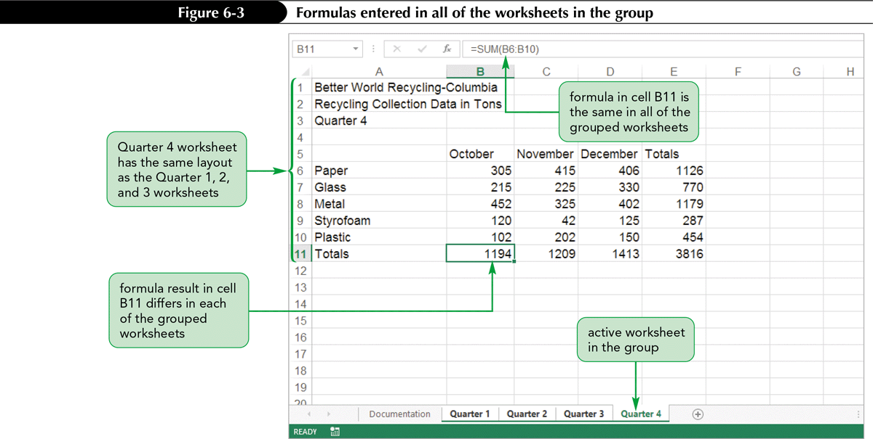
Grouping Worksheets

Slide 11
Grouping Worksheets
Formatting a Worksheet Group
  Any formatting changes made to the active worksheet are applied to all worksheets in the group
Ungrouping Worksheets
  When worksheets are ungrouped, each one functions independently again
  If you forget to ungroup worksheets, any changes you make in one will be applied to all worksheets in the group

Slide 12
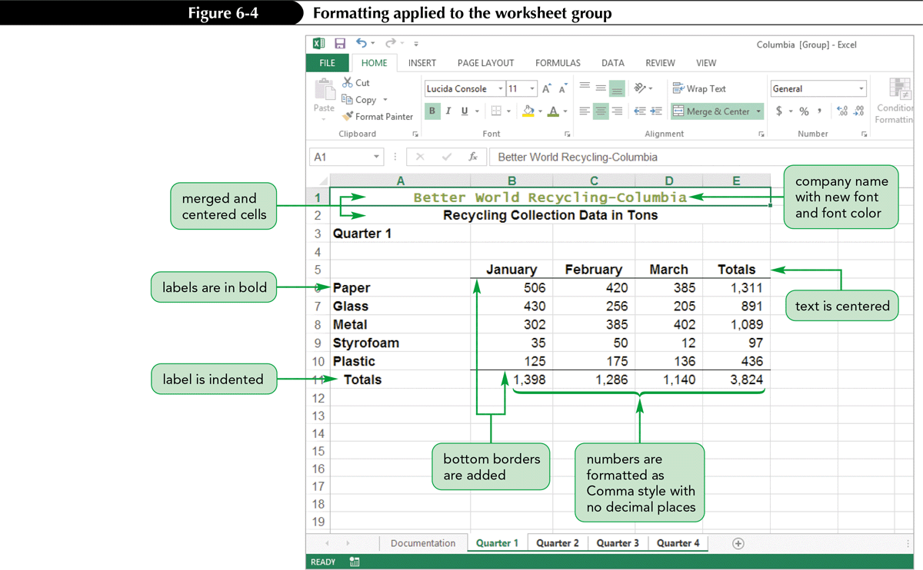
Formatted Grouped Worksheets

Slide 13
Working with
Multiple Worksheets
Copying Worksheets
  Use an existing worksheet as a starting point for creating another one
  Duplicates all values, formulas, and formats into new worksheet, leaving original worksheet intact
  Edit, reformat, and enter new content as needed

Slide 14
Working with
Multiple Worksheets
Referencing Cells and Ranges in Other Worksheets
  Using multiple worksheets to organize related data allows you to reference a cell or range in another worksheet in the same workbook
  You can type the formula in the cell, but it is faster and more accurate to use your mouse to select cells to enter their references to other worksheets

Slide 15
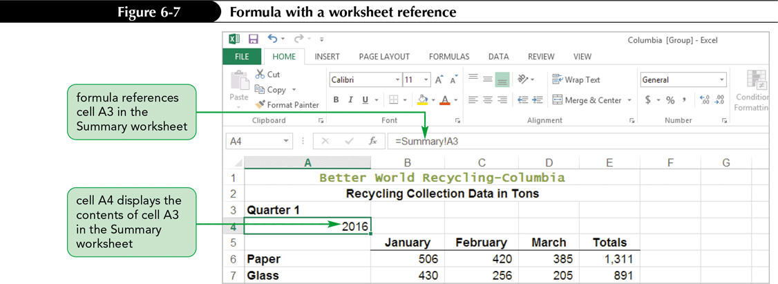
Working with
Multiple Worksheets
  The syntax to reference a cell or a range in a different worksheet is:
  =SheetName!CellRange

Slide 16
Working with
Multiple Worksheets
Using 3-D References to Add Values Across Worksheets
  When worksheets have identical row and column layouts, enter formulas with 3-D references to summarize the worksheets in another worksheet
  3-D reference specifies not only the range of rows and columns, but also the range of worksheet names in which the cells appear
  General syntax of a 3-D cell reference is:
  WorksheetRange!CellRange

Slide 17
Working with
Multiple Worksheets
Using 3-D References to Add Values Across Worksheets
  If you change the value in one worksheet, the results of formulas that reference that cell reflect the change in all grouped worksheets
  3-D references are often used in formulas that contain Excel functions, including:
    SUM
    AVERAGE
    COUNT
    MAX and MIN

Slide 18
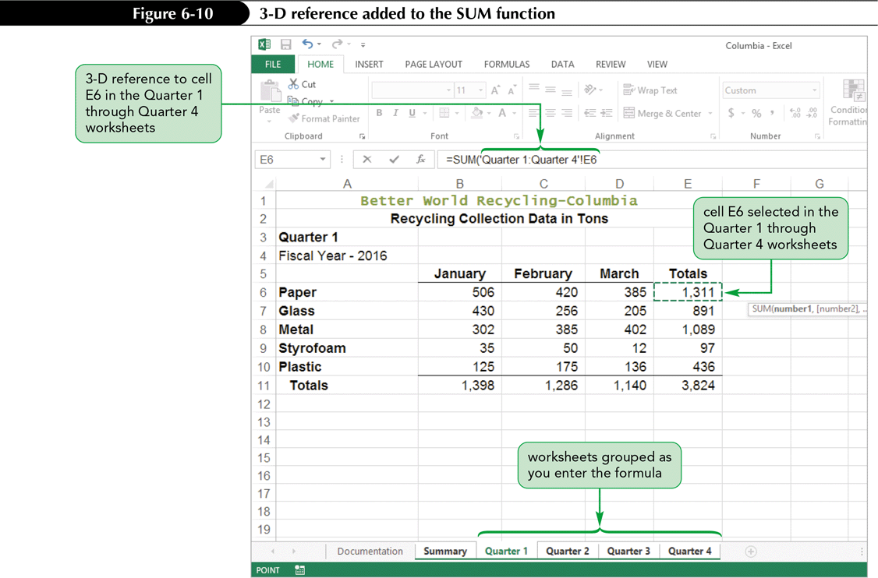
Working with
Multiple Worksheets

Slide 19
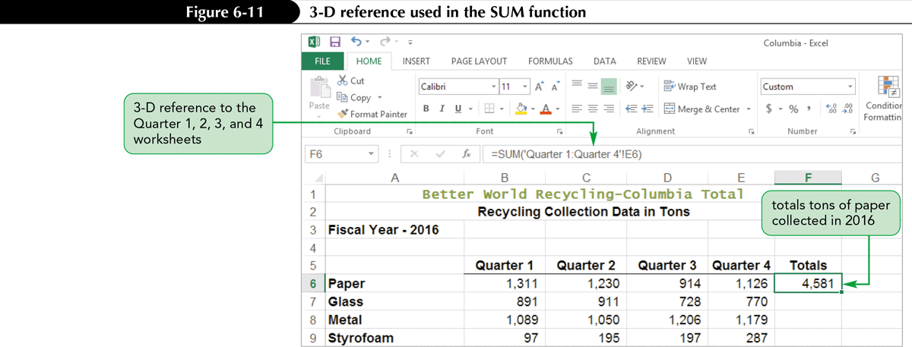
Working with
Multiple Worksheets

Slide 20
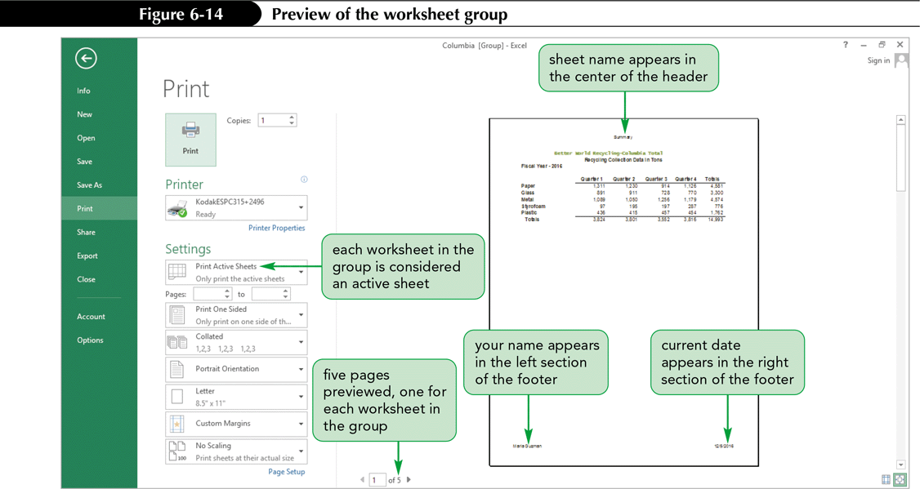
Printing a Worksheet Group
Same page layout settings apply to all worksheets in the group at the same time
All worksheets in the group can be printed at once

Slide 21
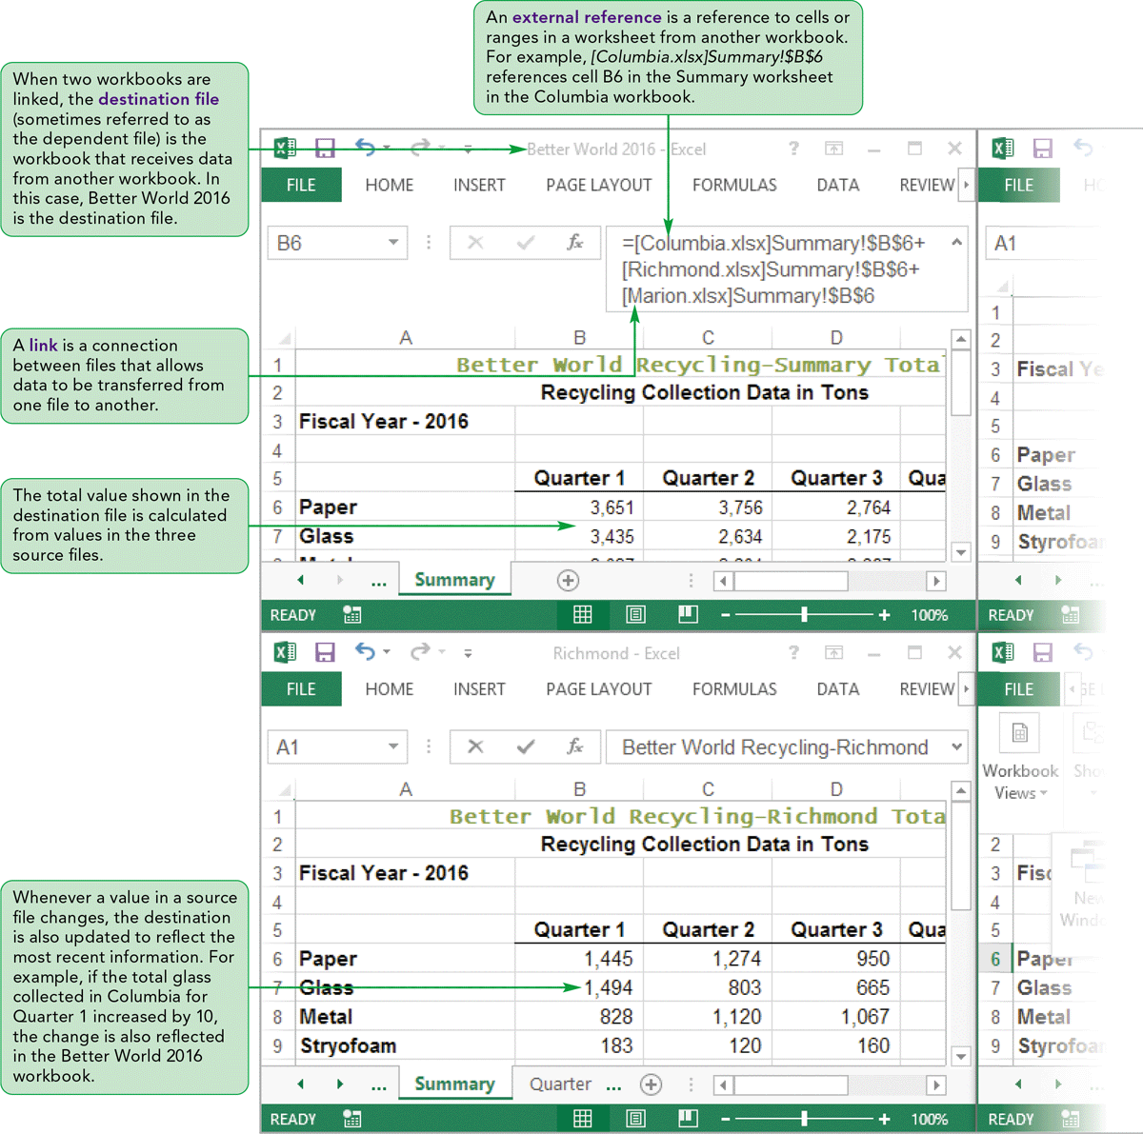
Visual Overview:
Links and External References

Slide 22
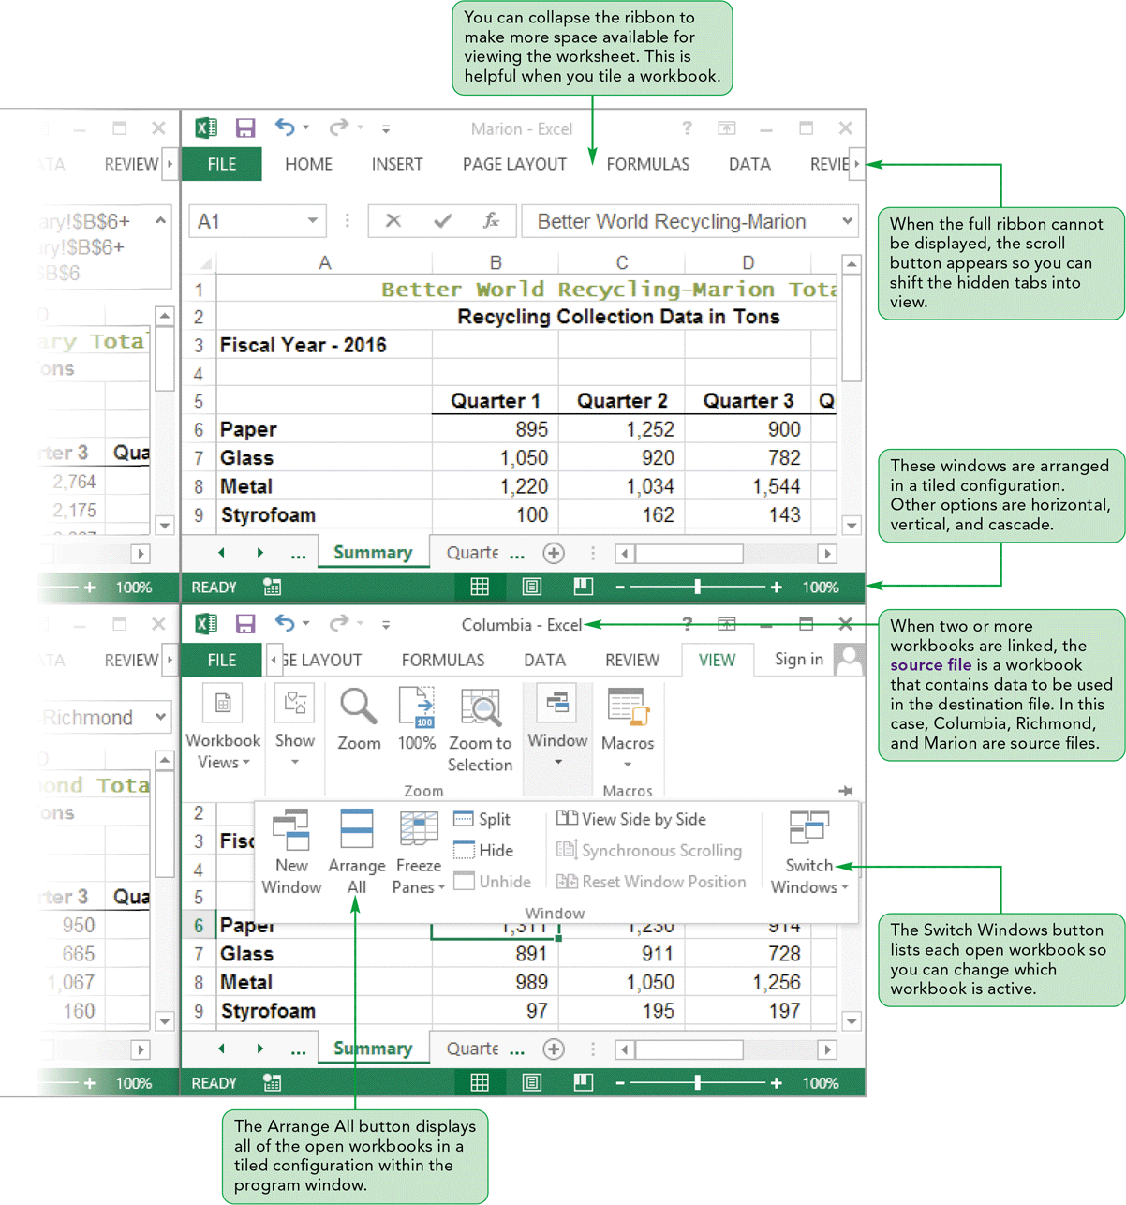
Visual Overview:
Links and External References

Slide 23
Linking Workbooks
When creating formulas in a workbook, reference data in other workbooks by creating a link between the workbooks
When two files are linked, the source file contains the data, and the destination file (dependent file) receives the data
When source and destination workbooks are in different folders, workbook reference must include the file’s complete location (the path)

Slide 24
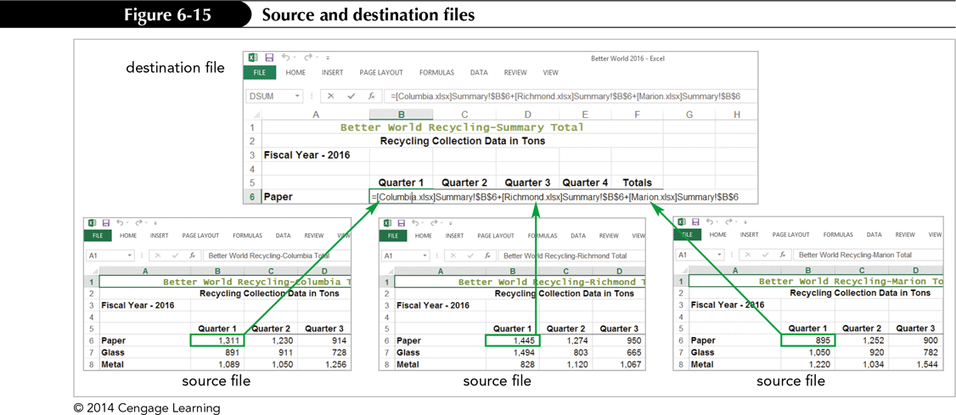
Linking Workbooks

Slide 25
Linking Workbooks
Navigating Multiple Workbooks
  To move between open workbooks:
    Use Switch Windows button in the Window group on the VIEW tab lists
    - or -
    Click Excel program button on the taskbar, then click the thumbnail of the workbook

Slide 26
Linking Workbooks
Arranging Multiple Workbooks
  Can display all the open workbooks on your screen at the same time
  Can easily click among the open workbooks to create links as well as quickly compare the contents of worksheets in different workbooks
  Layout options:
    Tiled
    Horizontal
    Vertical
    Cascade

Slide 27
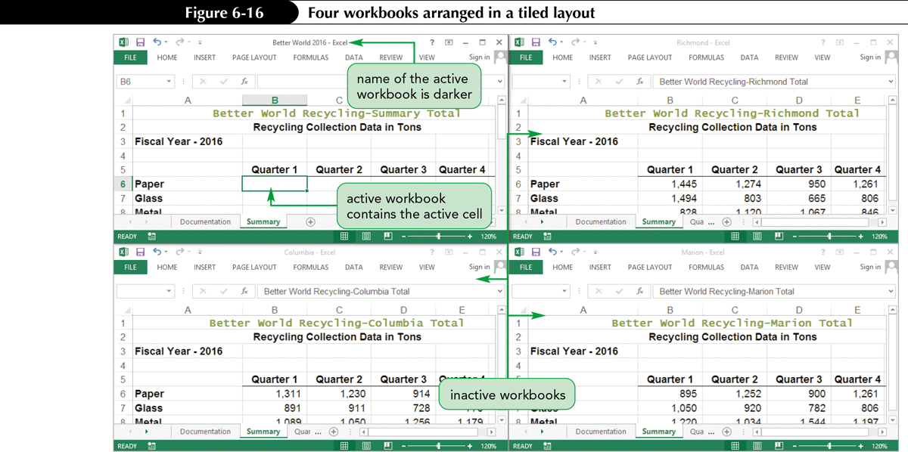
Linking Workbooks

Slide 28
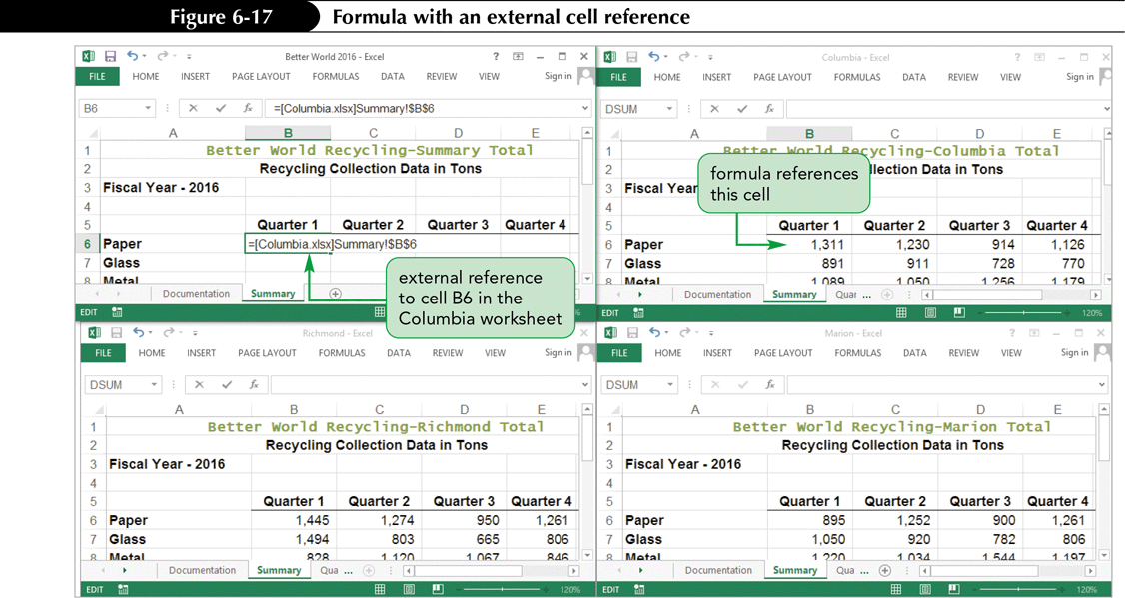
Linking Workbooks
Creating Formulas with External References
  A formula can include a reference to another workbook (external reference), which creates a set of linked workbooks

Slide 29
Updating Linked Workbooks
When data in a source file changes, the destination file should reflect those changes
If source and destination files are open when a change is made, the destination file is updated automatically
If destination file is closed when source file is changed, you choose whether to update the link to display current values, or continue to display older values when you open the destination file

Slide 30
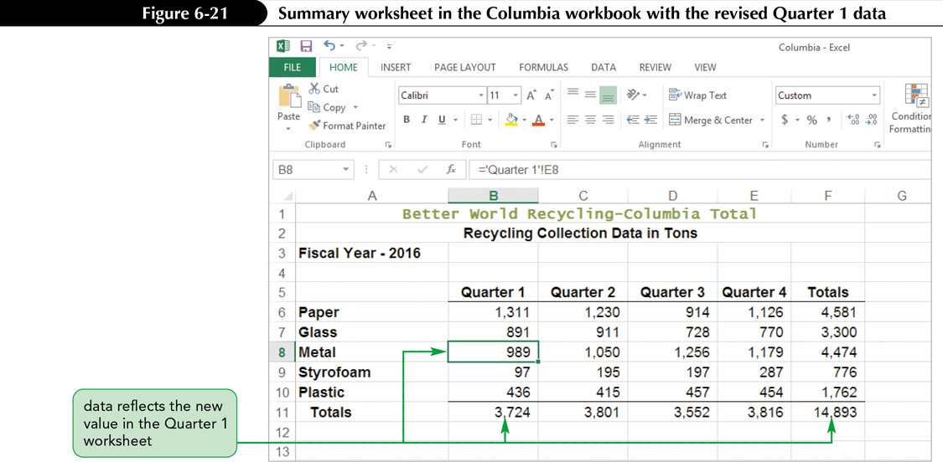
Updating Linked Workbooks
Updating a Destination Workbook with Source Workbooks Open

Slide 31
Updating Linked Workbooks
Updating a Destination Workbook with Source Workbooks Closed
  When you save a workbook that contains external reference formulas, Excel stores the most recent results of those formulas in the destination file
  Source files are often updated while the destination file is closed; the values in the destination file are not updated at the same time as the source files
  To update the destination workbook, you must specify that you want the update to occur

Slide 32
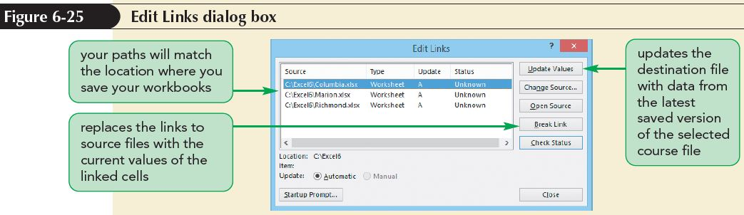
Updating Linked Workbooks
Managing Links
  Use Edit Links dialog box to manage links
    Review the status of the links and update the data in the files
    Repair broken links, which are references to files that have been moved since the link was created

Slide 33
Updating Linked Workbooks
Managing Links (continued)
  The Edit Links dialog box lists all of the files to which the destination workbook is linked so that you can update, change, open, or remove the links
  The dialog box shows the following information about each link:
    Source
    Type
    Update
    Status

Slide 34
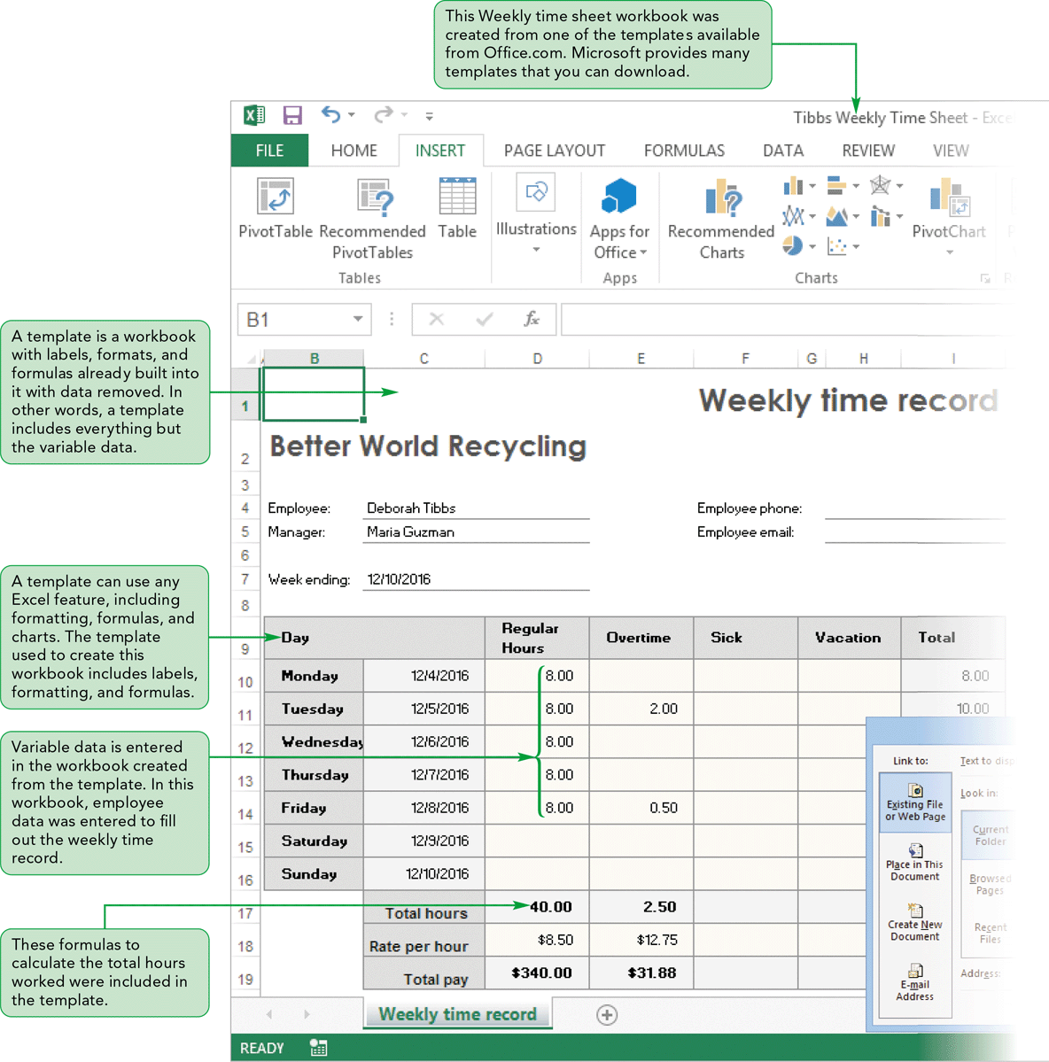
Visual Overview:
Templates and Hyperlinks

Slide 35
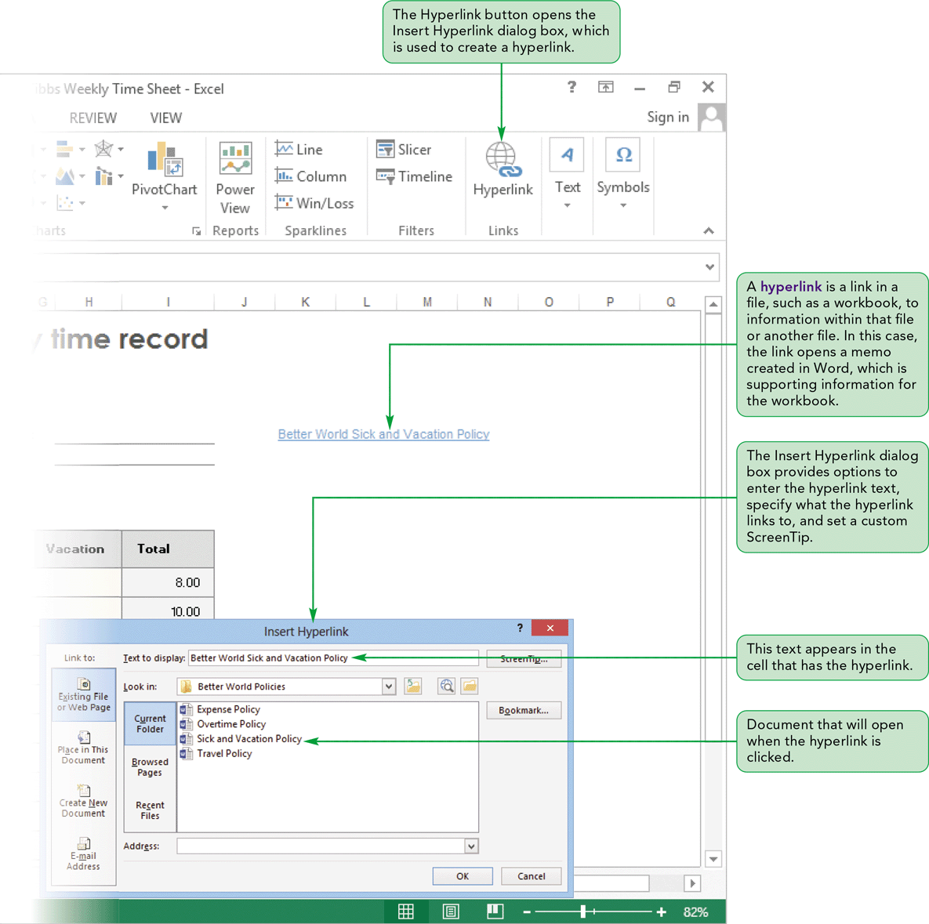
Visual Overview:
Templates and Hyperlinks

Slide 36
Creating a Hyperlink
A hyperlink is a link in a file to information within that file or another file
Can be used to:
  Quickly jump to a specific cell or range within the active worksheet, another worksheet, or another workbook
  Jump to other files (i.e., a Word document, a PowerPoint presentation, or a site on the web)

Slide 37
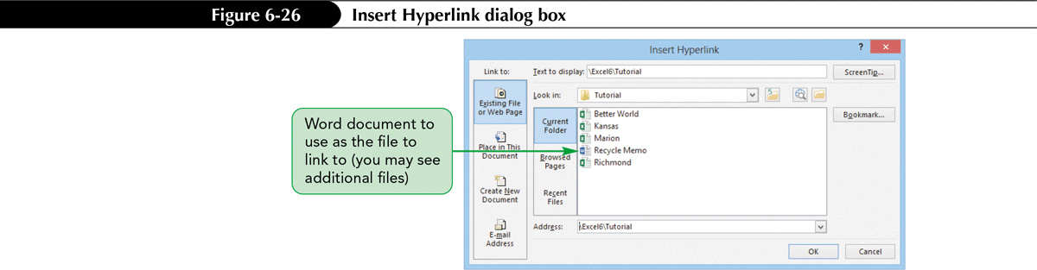
Creating a Hyperlink
Inserting a Hyperlink
  Insert a hyperlink directly in a workbook file to link to information in:
    That workbook
    Another workbook
    A file associated with another application on your computer, a shared file on a network, or a website

Slide 38
Creating a Hyperlink
Editing a Hyperlink
  Modify an existing hyperlink by:
    Changing its target file or webpage
    Modifying the text that is displayed
    Changing the ScreenTip for the hyperlink

Slide 39
Using Templates
A template workbook:
  Includes all text (row and column labels), formatting, and formulas, but no data
  Is a model from which you create new workbooks
Any changes or additions made to the new workbook do not affect the template file

Slide 40
Using Templates
Creating a Workbook Based on an Existing Template
  Excel has many templates available
    Some are automatically installed on your hard drive when you install Excel
    Other templates are available to download from the Office.com site
    Provide commonly used worksheet formats, saving you from “reinventing the wheel”
  Using a template lets you focus on the unique content for that workbook

Slide 41
Using Templates
Creating a Workbook Based on an Existing Template (continued)
  Some of the task-specific templates available from the Office.com site include:
    Family Monthly Budget Planner
    Inventory List
    Team Roster
    Time sheets
    Expense Report

Slide 42
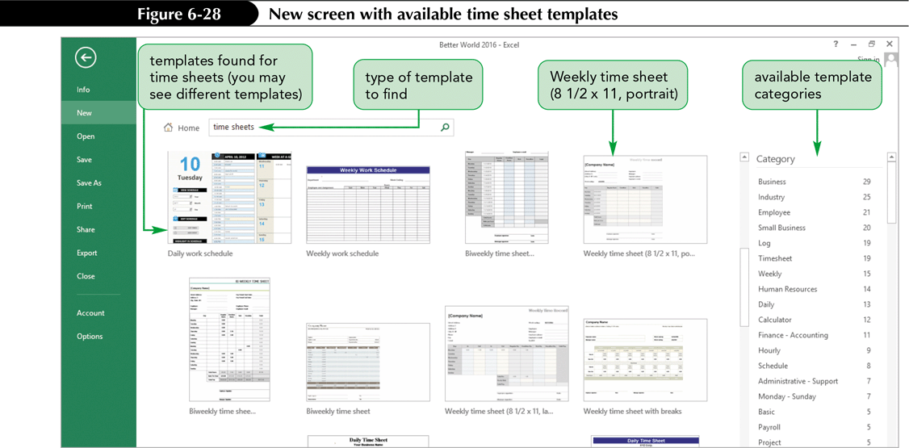
Using Templates

Slide 43
Using Templates
Creating a Custom Workbook Template
  A custom template is a workbook template you create that is ready to run with the formulas for all calculations included as well as all formatting and labels
  To create a custom template:
    Build the workbook with all necessary labels, formatting, and data
    Save the workbook as a template

Slide 44
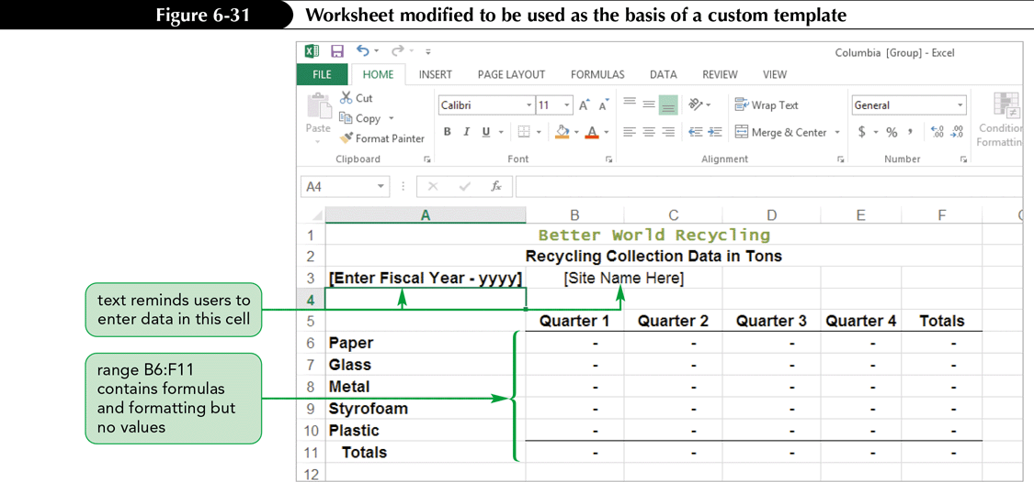
Using Templates

Slide 45
Using Templates
Creating a New Workbook from a Template
  A template file has special properties that allow you to open it, make changes, and save it in a new location
  After you have saved a template, you can access the template from the New screen in Backstage view or in the location you saved it
  The original template file is not changed by the process of entering data

Slide 46
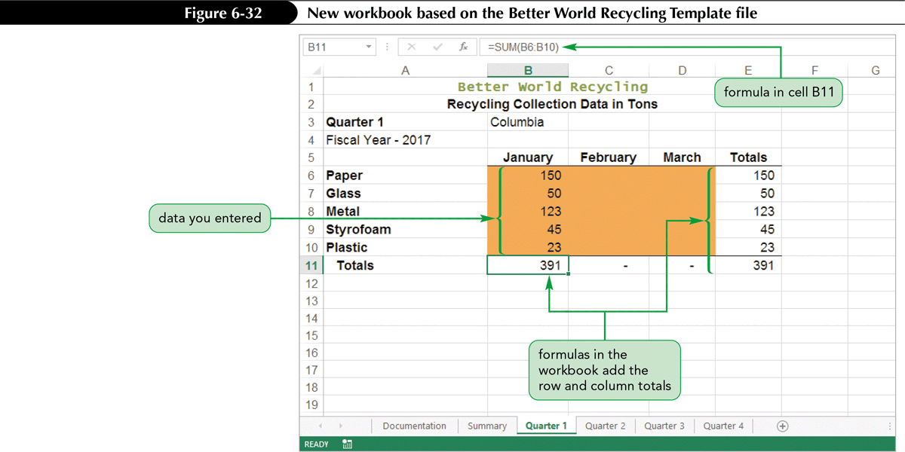
Using Templates

